Slide 1


SYNOPSIS
Presentation by Team:- CodeCrafters
Team id:- 26E2099

Slide 2





OUR TEAM
CodeCrafters
NEETU
ARCHIT
MAANYA
VANSHIKA
JAYA

Slide 3

THE IDEA
CodeCrafters
Autonomous Quadruped
The idea is to create an IoT-enabled quadruped robotic surveillance system that can safely operate in hazardous and confined environments where human access and wheeled robots are ineffective.
By leveraging quadruped mobility, advanced environmental sensors, and secure real-time data streaming, the robot autonomously navigates rough terrain while capturing visual, thermal, and positional data. All mission data is stored securely and made accessible through a web-based dashboard, enabling remote research teams to monitor, analyze, and respond to critical situations without physical exposure to danger.

Slide 4
THE BENEFIT
CodeCrafters
The system enhances autonomous surveillance research by combining quadruped mobility with networked environmental sensing for operation in hazardous and confined spaces. Its adaptive locomotion and multi-sensor perception improve navigation and anomaly detection in complex terrains. Secure, centralized data management enables systematic analysis and collaboration while reducing human exposure. Overall, the platform provides a scalable and research- oriented foundation for intelligent robotic monitoring systems.

Slide 5
KEY FEATURES
CodeCrafters
Multi-Sensor Environmental Perception
Autonomous Navigation & Path Following
Real-Time Visual Data Streaming
Web-Based Monitoring Dashboard
Secure IoT-Based Data
Infrastructure

Slide 6

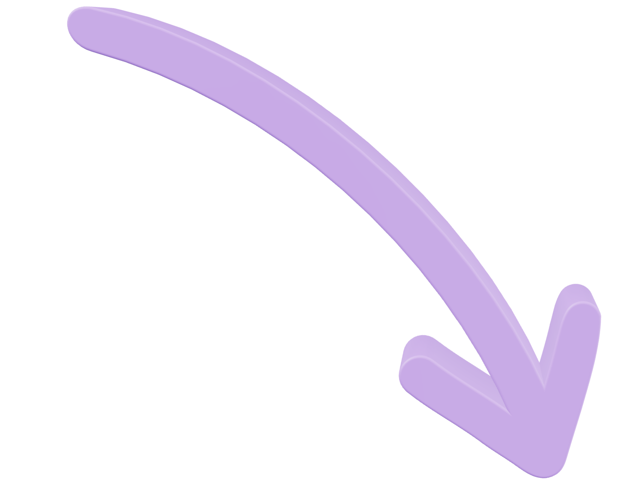
SCOPE &
CodeCrafters
LIMITATIONS
The project focuses on developing an IoT-enabled quadruped robotic system
The system’s operation time is
for surveillance in hazardous and confined environments. It integrates quadruped locomotion with sensors
limited by battery capacity and power usage. Autonomous navigation is confined to predefined paths
such as LiDAR, ultrasonic, thermal, and IMU for stable navigation and environmental monitoring. The system
without advanced learning-based decision-making. Performance may be affected by poor network
supports real-time data streaming, secure storage in a MongoDB database, and remote access through a web-
connectivity and extreme
environmental conditions, and the payload capacity is restricted by the
based dashboard for collaborative research and analysis.
physical constraints of the
quadruped platform.

Slide 7
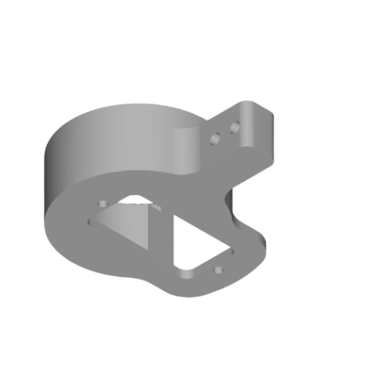
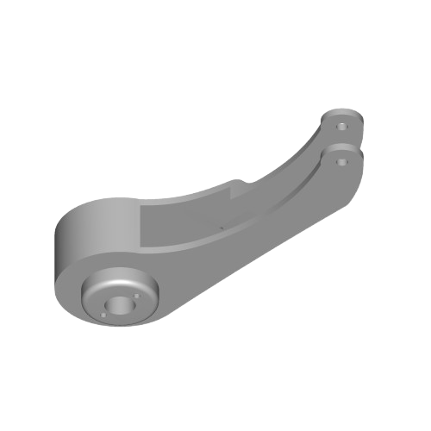
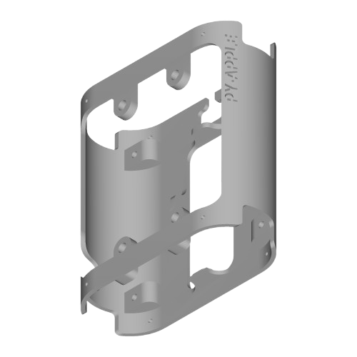
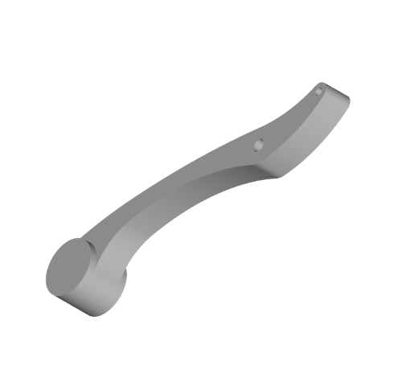
3D STRUCTURE
CodeCrafters

Slide 8
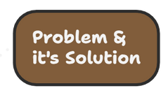
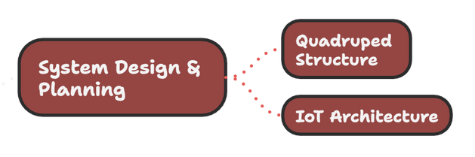
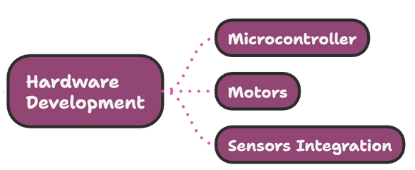
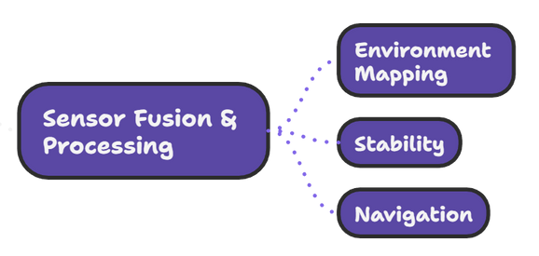
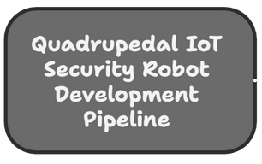
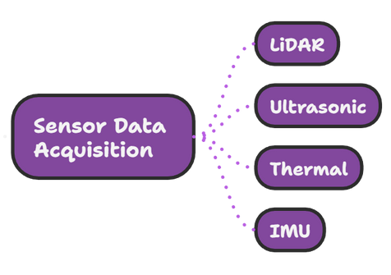
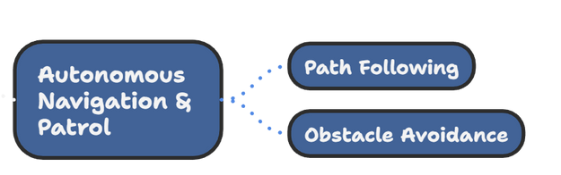
METHODOLOGY
CodeCrafters

Slide 9
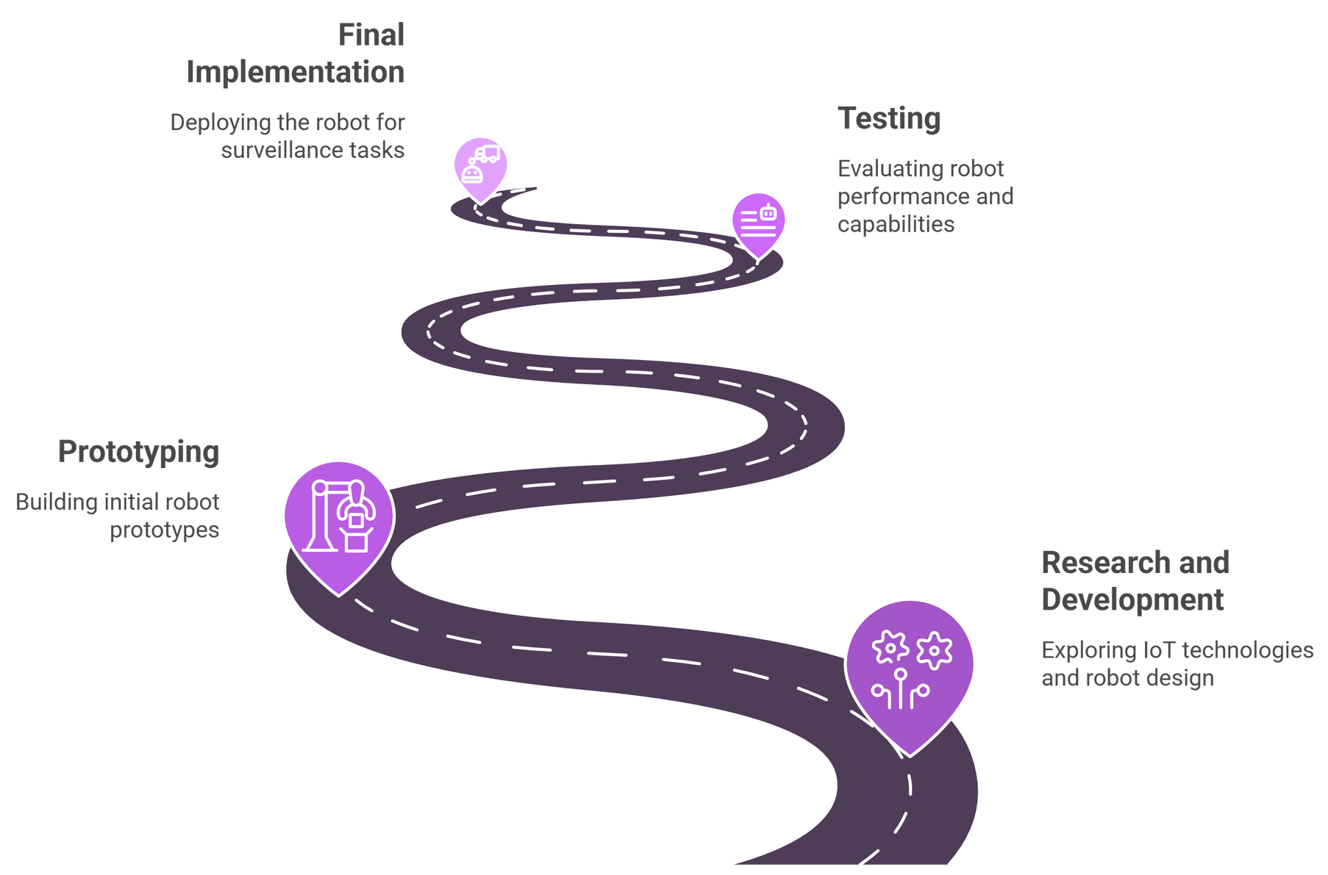
PROJECT TIMEFRAME
CodeCrafters

Slide 10

CodeCrafters

